Slide 1
Temperature and Heat

Slide 2
Temperature and Its Measurement
If two objects are in contact with one another long enough, the two objects have the same temperature.
This begins to define temperature, by defining when two objects have the same temperature.
When the physical properties are no longer changing, the objects are said to be in thermal equilibrium.
Two or more objects in thermal equilibrium have the same temperature.
This is the zeroth law of thermodynamics.

Slide 3
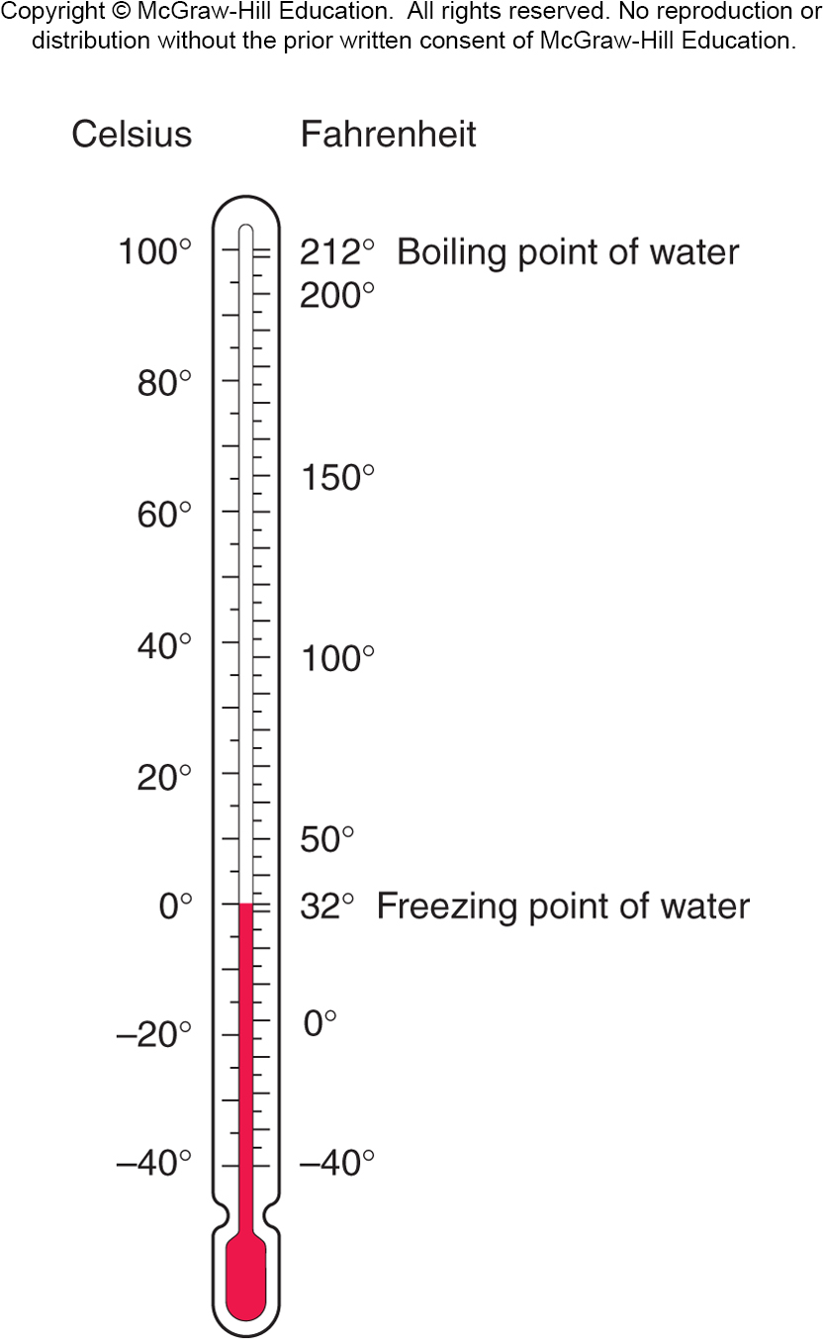
The first widely used temperature scale was devised by Gabriel Fahrenheit.
Another widely used scale was devised by Anders Celsius.
The Celsius degree is larger than the Fahrenheit degree: the ratio of Fahrenheit degrees to Celsius degrees is 180/100, or 9/5.
They are both equal at -40°.

Slide 4
The zero point on the Fahrenheit scale was based on the temperature of a mixture of salt and ice in a saturated salt solution.
The zero point on the Celsius scale is the freezing point of water.
Both scales go below zero.
Is there such a thing as absolute zero?

Slide 5
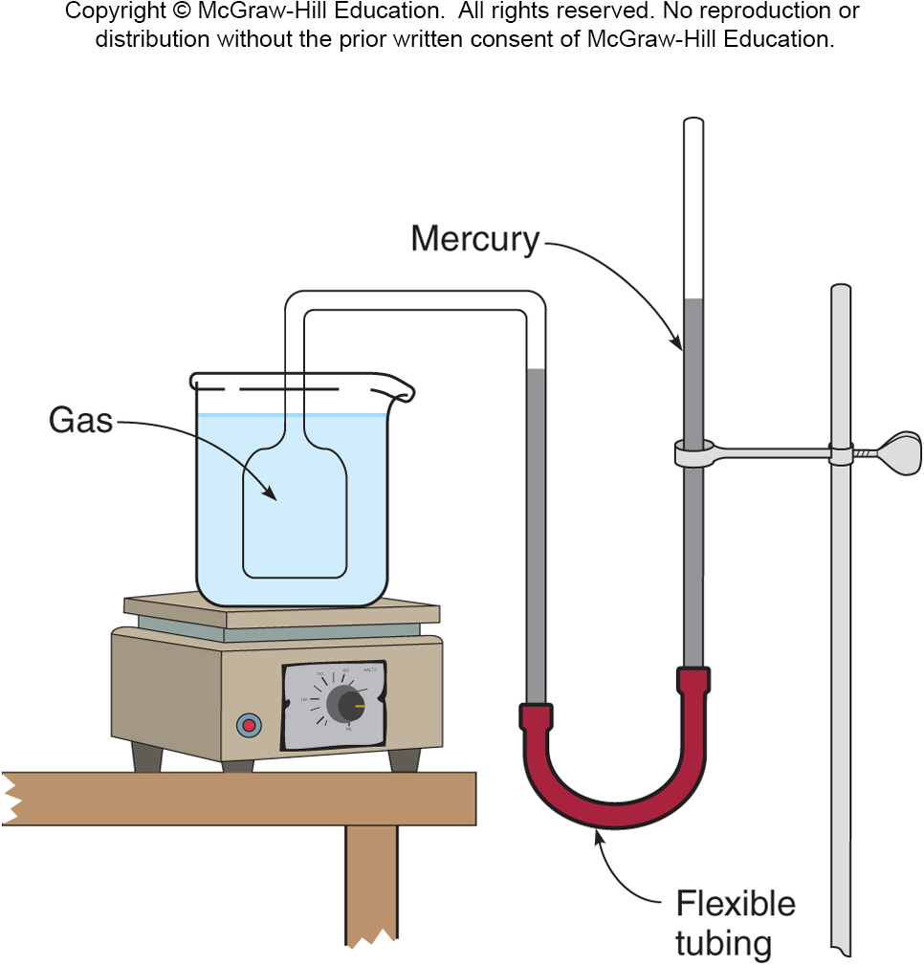
What is absolute zero?
If the volume of a gas is kept constant while the temperature is increased, the pressure will increase.
This can be used as a means of measuring temperature.
A constant-volume gas thermometer allows the pressure to change with temperature while the volume is held constant.
The difference in height of the two mercury columns is proportional to the pressure.

Slide 6
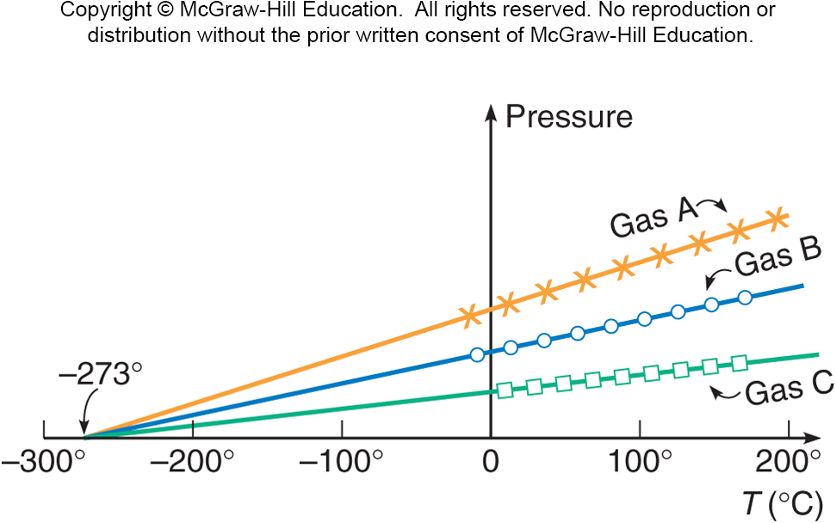
We can then plot the pressure of a gas as a function of the temperature.
The curves for different gases or amounts are all straight lines.
When these lines are extended backward to zero pressure, they all intersect at the same temperature, -273.2°C.
Since negative pressure has no meaning, this suggests that the temperature can never get lower than -273.2°C, or 0 K (kelvin).

Slide 7
Can anything ever get colder than 0 K?
No.
Can absolute zero ever be reached?
No.

Slide 8

Fun with Liquid Nitrogen

Slide 9
Even colder…liquid helium

Slide 10
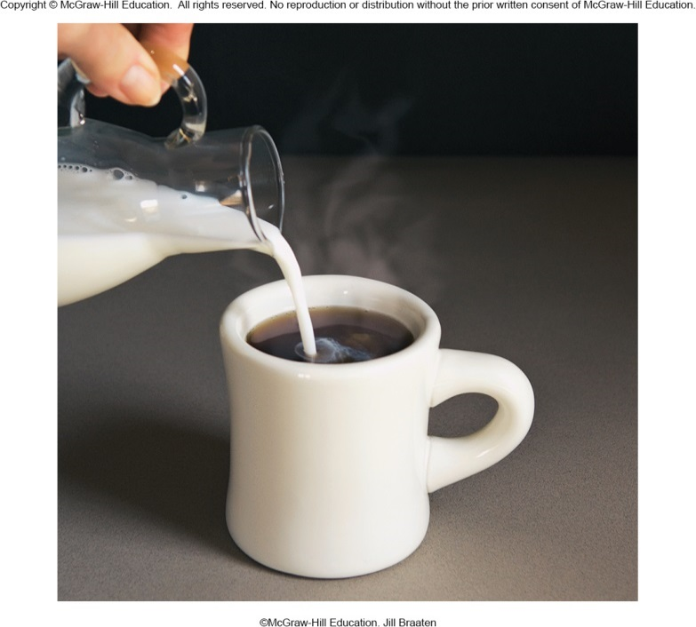
Heat and Specific Heat Capacity
What happens when objects or fluids at different temperatures come in contact with one another?
The colder object gets hotter, and the hotter object gets colder, until they both reach the same temperature.
What is it that flows between the objects to account for this?
We use the term heat for this quantity.

Slide 11
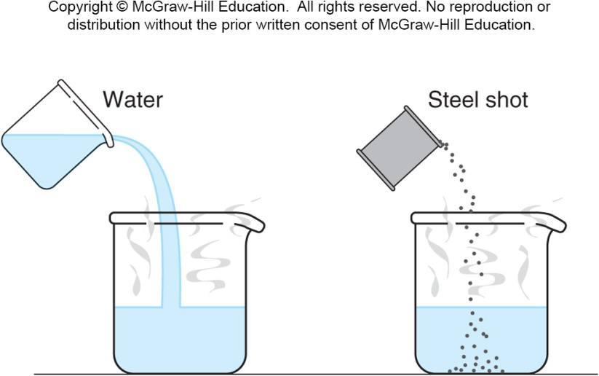
Heat and Specific Heat Capacity
Heat flow is a form of energy transfer between objects.
One-hundred grams of room-temperature water is more effective than 100 grams of room-temperature steel shot in cooling a hot cup of water.
Steel has a lower specific heat capacity than water.
The specific heat capacity of a material is the relative amount of heat needed to raise its temperature.

Slide 12
The specific heat capacity of a material is the quantity of heat needed to change a unit mass of the material by a unit amount in temperature.
For example, to change 1 gram by 1 Celsius degree.
It is a property of the material, determined by experiment.
The specific heat capacity of water is 1 cal/g⋅C°: it takes 1 calorie of heat to raise the temperature of 1 gram of water by 1°C.
We can then calculate how much heat must be absorbed by a material to change its temperature by a given amount:
Q = mcΔT where Q = quantity of heat
m = mass
c = specific heat capacity
ΔT = change in temperature

Slide 13
James Prescott Joule

Slide 14
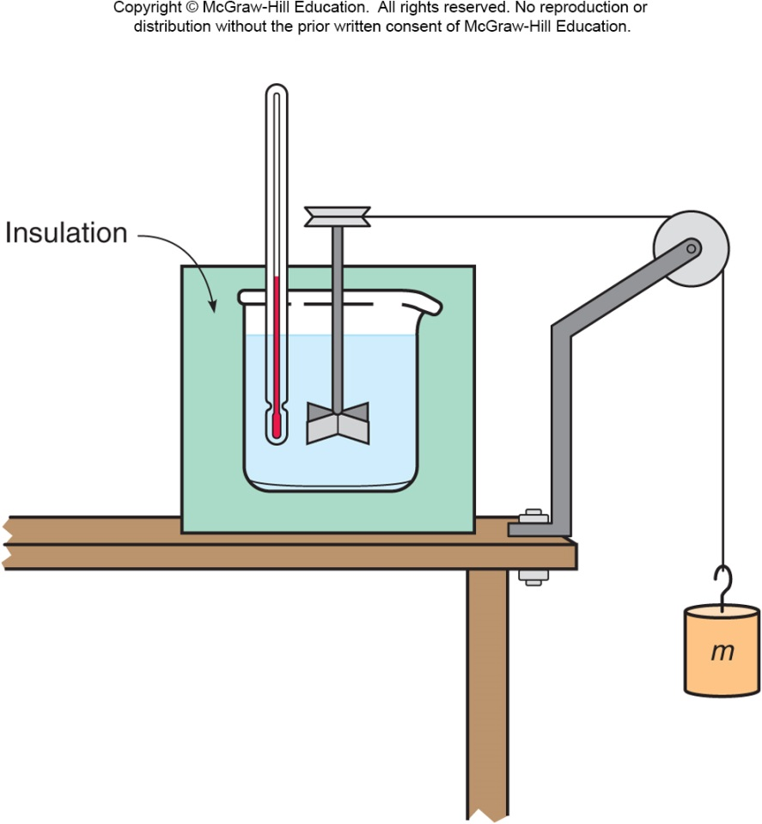
Joule’s Experiment and the First Law of Thermodynamics
Rumford noticed that cannon barrels became hot during drilling.
Joule performed a series of experiments showing that mechanical work could raise the temperature of a system.
In one such experiment, a falling mass turns a paddle in an insulated beaker of water, producing an increase in temperature.

Slide 15
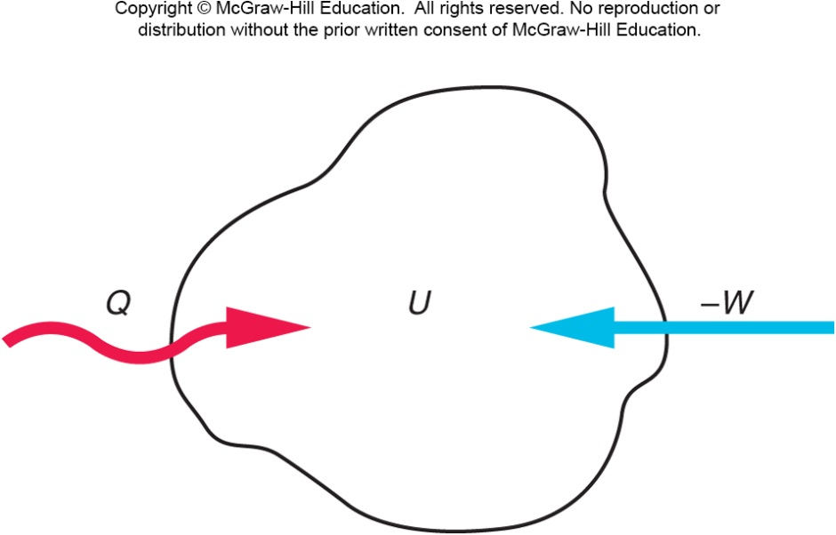
Joule’s Experiment and the First Law of Thermodynamics
Joule’s experiments led to Kelvin’s statement of the first law of thermodynamics.
Both work and heat represent transfers of energy into or out of a system.
If energy is added to a system either as work or heat, the internal energy of the system increases accordingly.
The increase in the internal
energy of a system is equal
to the amount of heat added
to a system minus the
amount of work done by the
system. ΔU = Q - W

Slide 16
Joule’s Experiment and the First Law of Thermodynamics
This introduced the concept of the internal energy of a system.
An increase in internal energy may show up as an increase in temperature, or as a change in phase, or any other increase in the kinetic and/or potential energy of the atoms or molecules making up the system.
Internal energy is a property of the system uniquely determined by the state of the system.
The internal energy of the system is the sum of the kinetic and potential energies of the atoms and molecules making up the system.

Slide 17
The Flow of Heat
There are three basic processes for heat flow:
Conduction
Convection
Radiation

Slide 18
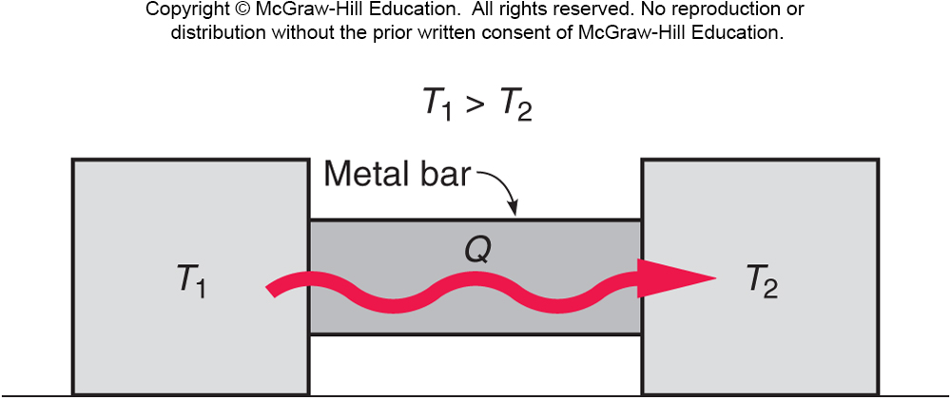
In conduction, heat flows through a material when objects at different temperatures are placed in contact with one another.

Slide 19
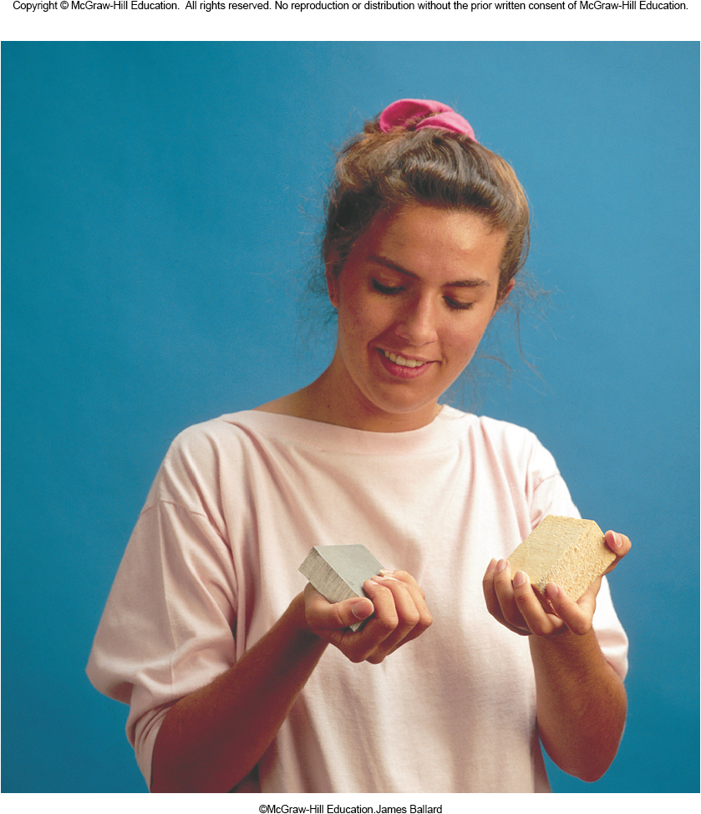
Conduction
The rate of heat flow depends on the temperature difference between the objects.
It also depends on the thermal conductivity of the materials, a measure of how well the materials conduct heat.
For example, a metal block at room temperature will feel colder than a wood block of the exact same temperature.
The metal block is a better thermal conductor, so heat flows more readily from your hand into the metal.
Since contact with the metal cools your hand more rapidly, the metal feels colder.

Slide 20
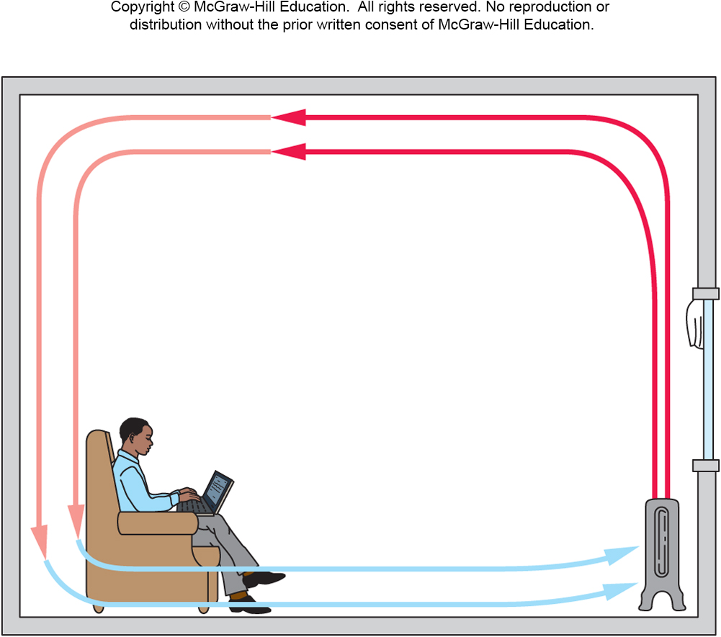
In convection, heat is transferred by the motion of a fluid containing thermal energy.
Convection is the main method of heating a house.
It is also the main method heat is lost from buildings.

Slide 21
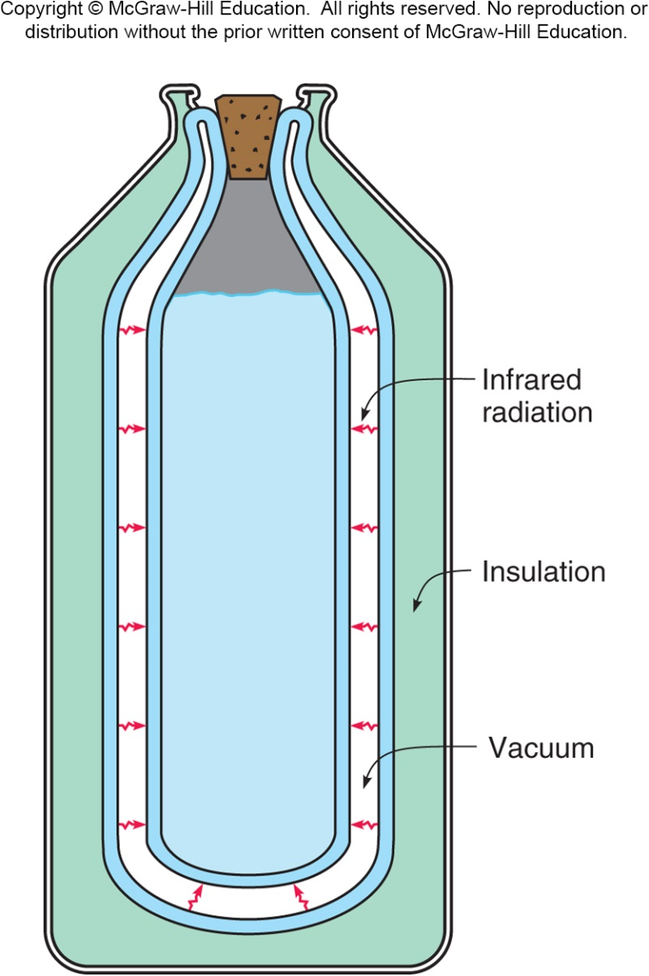
In radiation, heat energy is transferred by electromagnetic waves.
The electromagnetic waves involved in the transfer of heat lie primarily in the infrared portion of the spectrum.
Unlike conduction and convection, which both require a medium to travel through, radiation can take place across a vacuum.
For example, the evacuated space in a thermos bottle.
The radiation is reduced to a minimum by silvering the facing walls of the evacuated space.

Slide 22
What process makes a car’s interior heat up when parked in the sun?
radiation
Why are houses insulated with material in the walls instead of just empty space?
To reduce convection and conduction
Why is this insulated material often foil-backed?
To limit radiation
Is a light-colored roof or a dark-colored roof more energy efficient?
Light colored roofs keep a house cooler reducing cooling costs.

Slide 23
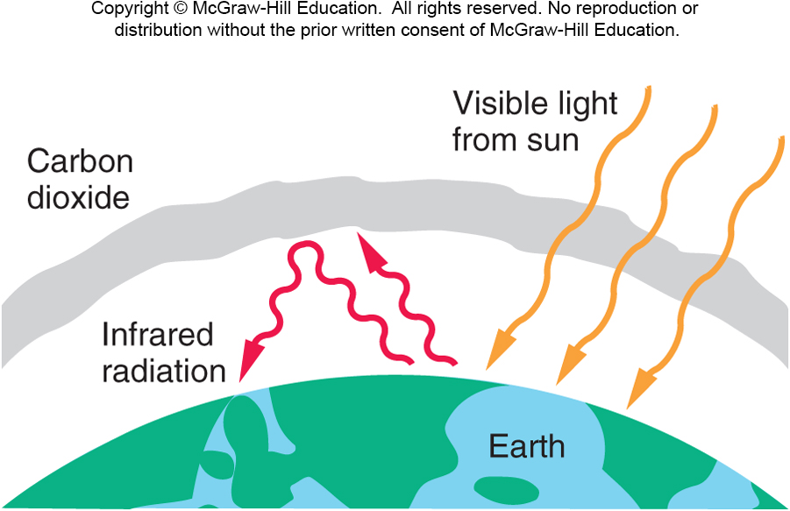
What heat-flow processes are involved in the greenhouse effect?

Slide 24
Leidenfrost Effect

Slide 25
Heat Engines and the Second Law of Thermodynamics

Slide 26

The laws of thermodynamics
...are critical to making intelligent choices about energy in today’s global economy.

Slide 27
Advances in Solar Energy

Slide 28
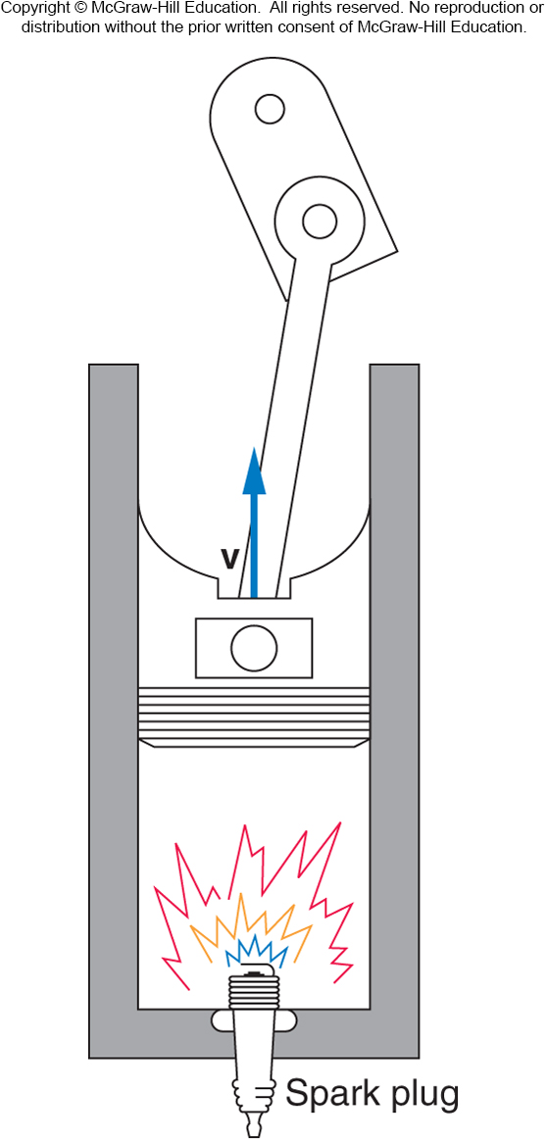
Heat Engines
A gasoline engine is a form of a heat engine.
Gasoline is mixed with air.
A spark ignites the mixture, which burns rapidly.
Heat is released from the fuel as it burns.
The heat causes the gases in the cylinder to expand, doing work on the piston.
The work done on the piston is transferred to the drive shaft and wheels.

Slide 29
Heat Engines
The wheels push against the road.
According to Newton’s third law, the road exerts a force on the tires, allowing the car to move forward.
Not all the heat from burning fuel is converted to work done in moving the car.
The exhaust gases emerging from the tailpipe release heat into the environment.
Unused heat is a general feature of heat engines.

Slide 30
Heat Engine Example

Slide 31
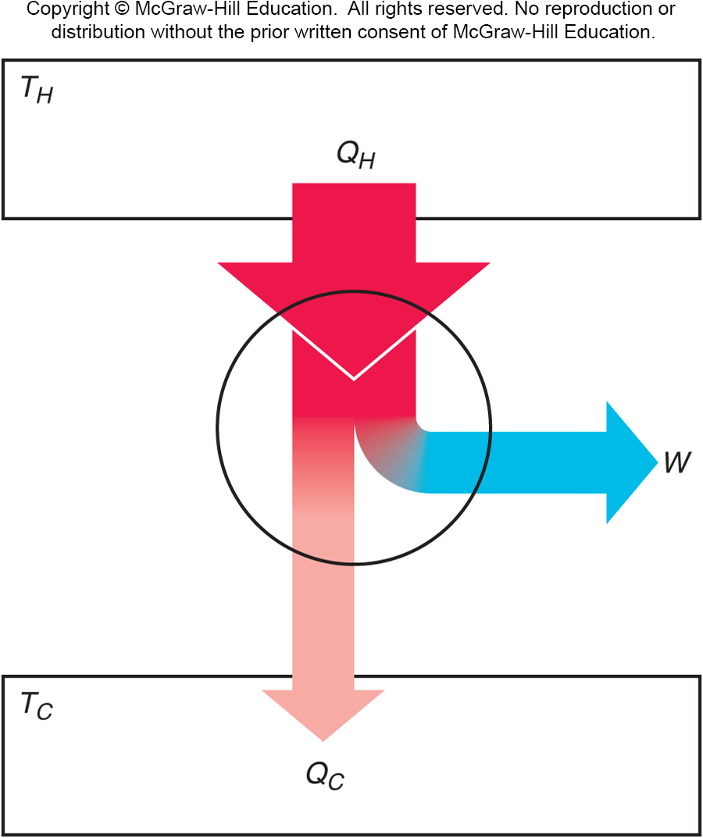
Heat Engines
All heat engines share these main features of operation:
Thermal energy (heat) is introduced into the engine.
Some of this energy is converted to mechanical work.
Some heat (waste heat) is released into the environment at a temperature lower than the input temperature.

Slide 32
Efficiency
Efficiency is the ratio of the net work done by the engine to the amount of heat that must be supplied to accomplish this work.

Slide 33
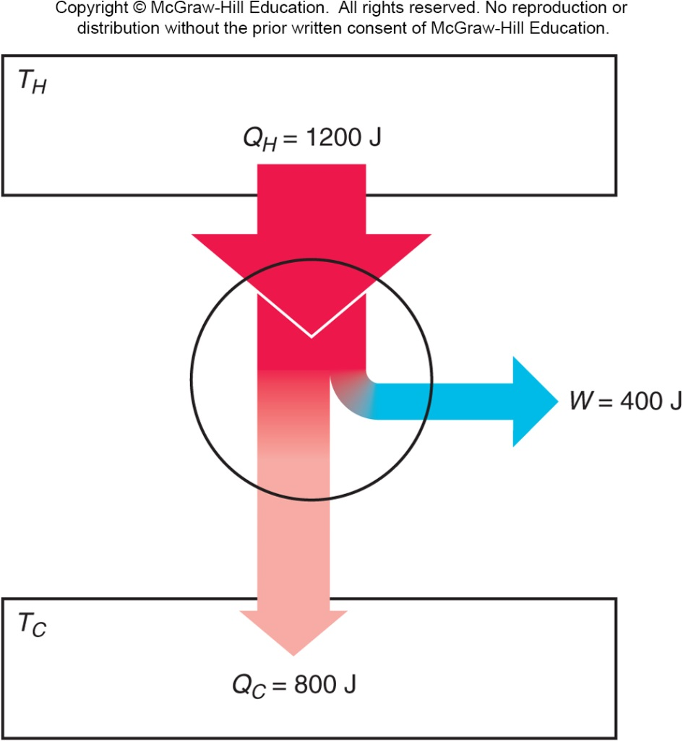
A heat engine takes in 1200 J of heat from the high-temperature heat source in each cycle, and does 400 J of work in each cycle. What is the efficiency of this engine?
33%
40%
66%
Q_{H} = 1200 J
W = 400 J
e = W / Q_{H}
= (400 J) / (1200 J)
= 1/3 = 0.33
= 33%

Slide 34
Carnot Engine
The efficiency of a typical automobile engine is less than 30%.
This seems to be wasting a lot of energy.
What is the best efficiency we could achieve?
What factors determine efficiency?
In analogy to water wheels, Carnot reasoned that the greatest efficiency of a heat engine would be obtained by taking all the input heat at a single high temperature and releasing all the unused heat at a single low temperature.

Slide 35
Carnot Engine and Carnot Cycle
Carnot also reasoned that the processes should occur without undue turbulence.
The engine is completely reversible: it can be turned around and run the other way at any point in the cycle, because it is always near equilibrium.
This is Carnot’s ideal engine.
The cycle devised by Carnot that an ideal engine would have to follow is called a Carnot cycle.
An (ideal, not real) engine following this cycle is called a Carnot engine.

Slide 36
Carnot Efficiency
The efficiency of Carnot’s ideal engine is called the Carnot efficiency and is given by:
This is the maximum efficiency possible for any engine taking in heat from a reservoir at absolute temperature T_{H} and releasing heat to a reservoir at temperature T_{C}.
Even Carnot’s ideal engine is less than 100% efficient.

Slide 37
A steam turbine takes in steam at a temperature of 400°C and releases steam to the condenser at a temperature of 120°C. What is the Carnot efficiency for this engine?
30%
41.6%
58.4%
70%
T_{H} = 400°C = 673 K
T_{C} = 120°C = 393 K
e_{C} = (T_{H} - T_{C} ) / T_{H}
= (673 K - 393 K) / (673 K)
= 280 K / 673 K
= 0.416 = 41.6%

Slide 38
Second Law of Thermodynamics
No engine, working in a continuous cycle, can take heat from a reservoir at a single temperature and convert that heat completely to work.
Therefore, no engine can have a greater efficiency than a Carnot engine operating between the same two temperatures.

Slide 39
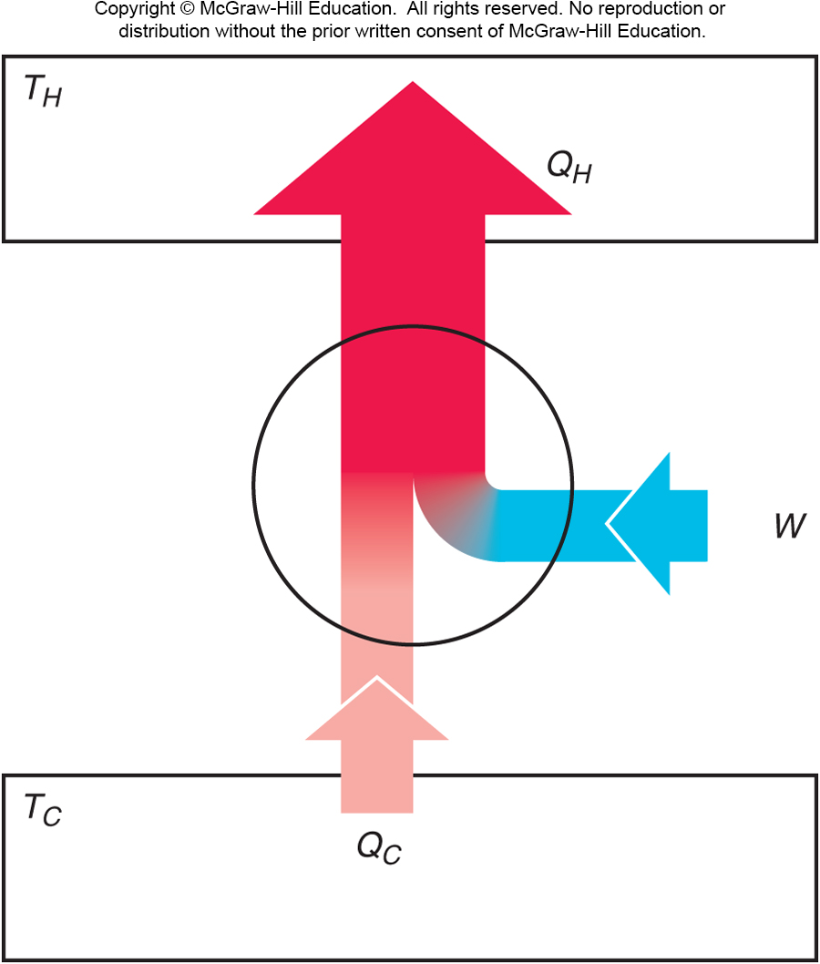
Refrigerators, Heat Pumps, and Entropy
If a heat engine is run in reverse, then work W is done on the engine as heat Q_{C} is removed from the lower-temperature reservoir and a greater quantity of heat Q_{H} is released to the higher-temperature reservoir.
A device that moves heat from a cooler reservoir to a warmer reservoir by means of work supplied from some external source is called a heat pump.

Slide 40
The first law of thermodynamics requires that, for a complete cycle, the heat released at the higher temperature must equal the energy put into the engine in the form of both heat and work.
The engine returns to its
initial condition at the end
of each cycle; the internal
energy of the engine does
not change.
More heat is released at
the higher temperature
than was taken in at the
lower temperature.

Slide 41
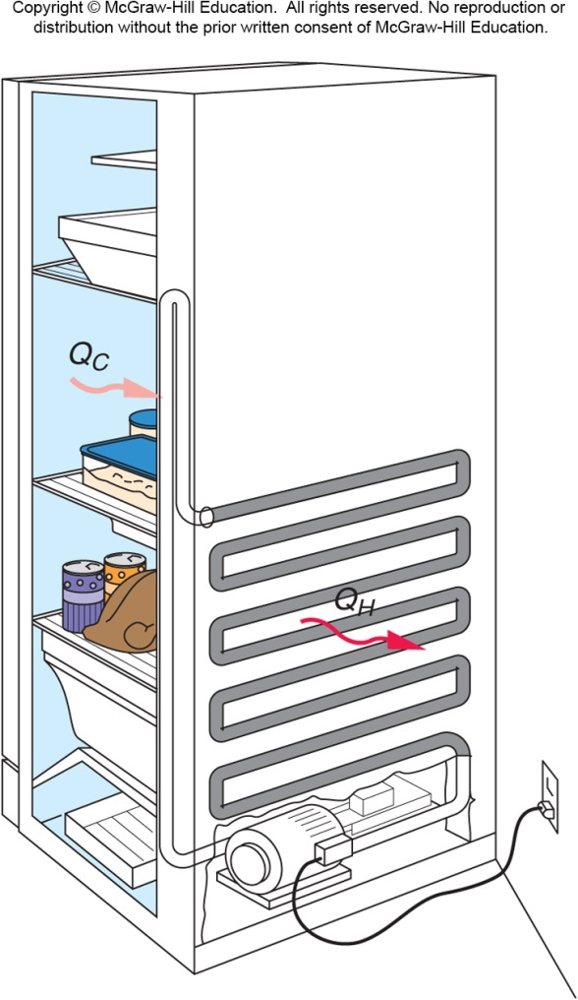
Refrigerators and Heat Pumps
A refrigerator is also a form of a heat pump.
It also moves heat from a cooler reservoir to a warmer reservoir by means of work supplied from some external source.
It keeps food cold by pumping heat out of the cooler interior of the refrigerator into the warmer room.
An electric motor or gas-powered engine does the necessary work.

Slide 42
Another Statement of The Second Law of Thermodynamics
Heat has a natural tendency to flow from hotter objects to colder objects. This can be expressed in a second statement of the second law of thermodynamics:
Heat will not flow from a colder body to a hotter body unless some other process is also involved.
For example, work can be used to pump heat against its usual direction of flow.

Slide 43
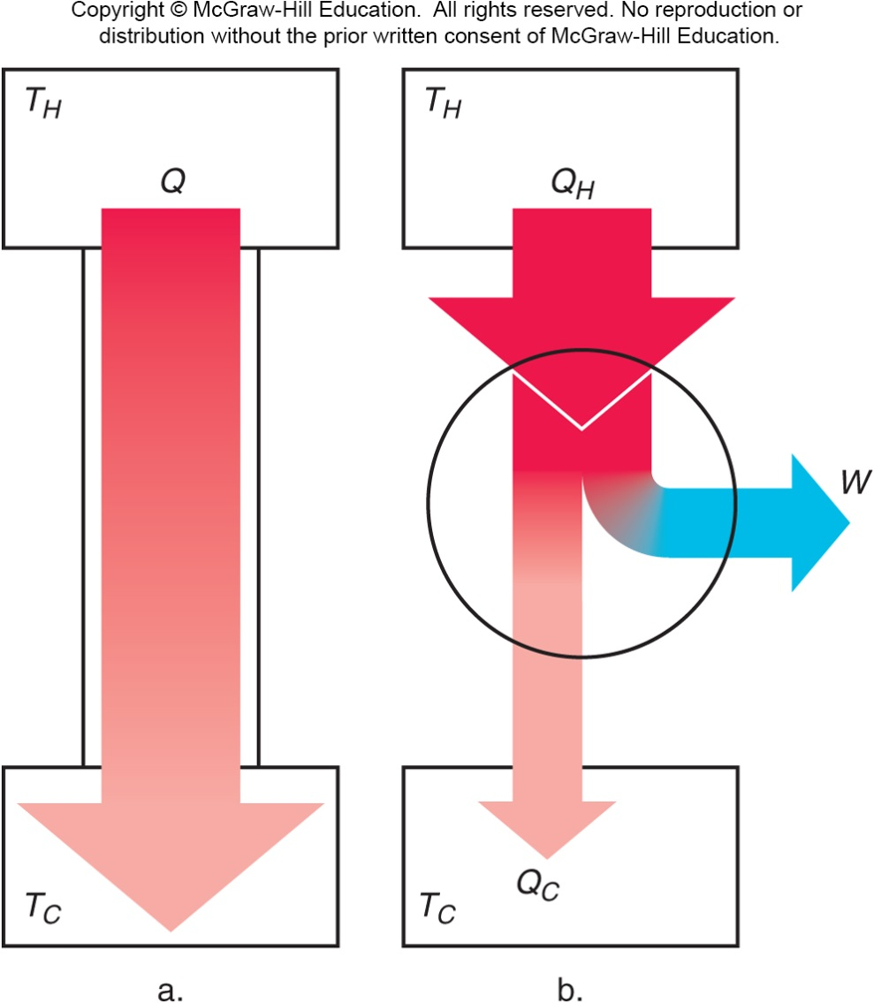
Entropy
Heat can be removed from a high-temperature source either by spontaneous flow to a low-temperature reservoir or by being used to run a heat engine.
If the engine is a Carnot engine, the process is completely reversible and the maximum possible work has been obtained from the available heat.

Slide 44
If the heat simply flows from hot to cold spontaneously, the process is irreversible and the energy is not converted to useful work.
In the irreversible process, we lose some ability to do useful work.
Entropy is the quantity
that describes the extent
of this loss.
Entropy is sometimes
defined as a measure of
the disorder of the system.
The entropy of a system
increases any time the
disorder or randomness of
the system increases.

Slide 45
A Third Statement of The Second Law of Thermodynamics
Entropy remains constant in reversible processes but increases in irreversible processes.
The entropy of a system decreases only if it interacts with some other system whose entropy is increased in the process.
This happens, for example, in the growth and development of biological organisms.
The entropy of the universe or of an isolated system can only increase or remain constant. Its entropy can never decrease.

Slide 46
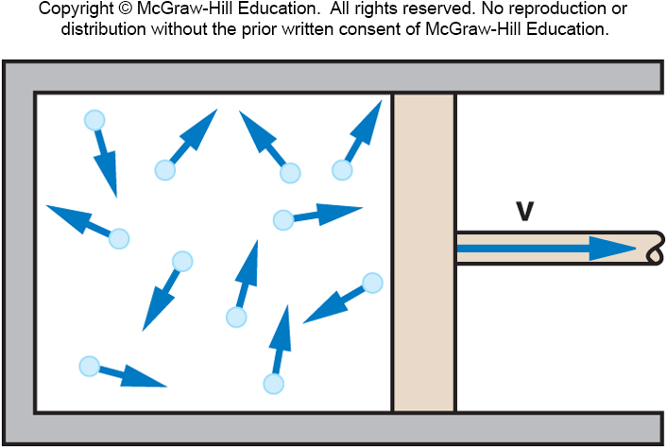
The thermal energy of a gas consists of the kinetic energy of the molecules.
The velocities of these
molecules are randomly
directed. Only some of
them move in the proper
direction to push the piston
to produce work.
The basic disorganization of heat energy is responsible for the limitations encompassed by the three statements of the second law.
The natural tendency of entropy to increase can only be countered by introducing energy into the system:
For example, solar energy to support biological processes on earth.
For example, work done to organize a room’s clutter.

Slide 47
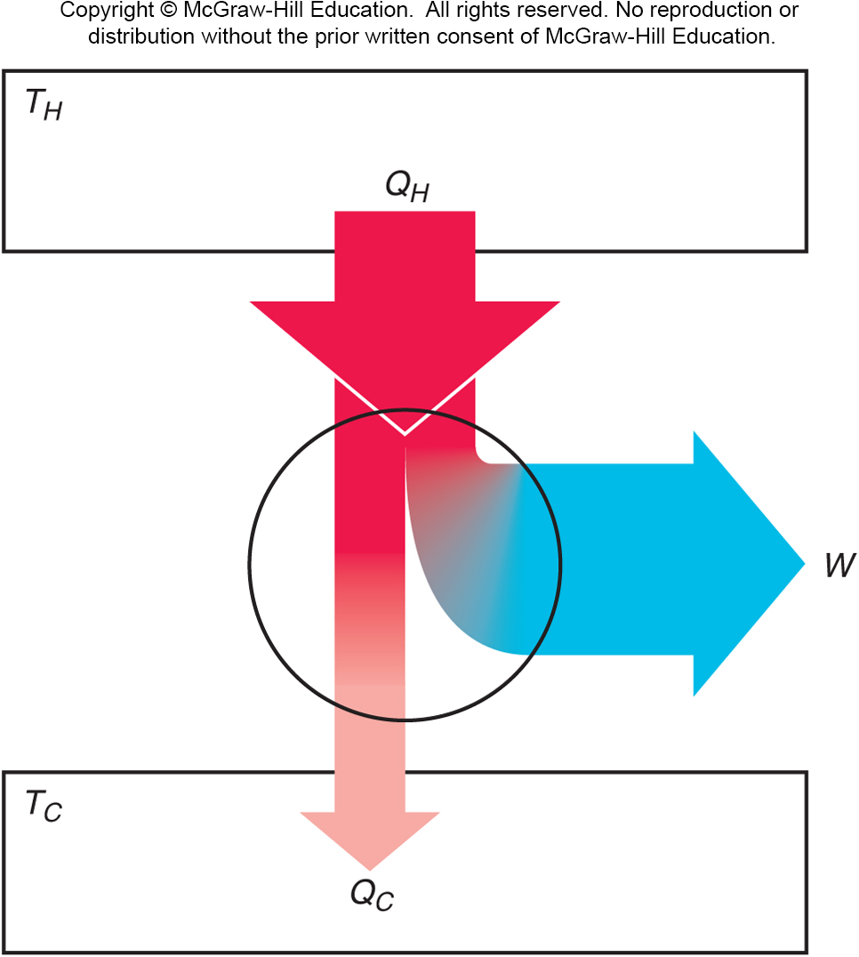
Perpetual Motion and Energy Fluids
A perpetual-motion machine of the first kind is a proposed engine of machine that would violate the first law of thermodynamics.
It puts out more energy as work or heat than it takes in.
Buyer beware:
Where is the energy coming from?
How can the machine put more energy out than went in?

Slide 48
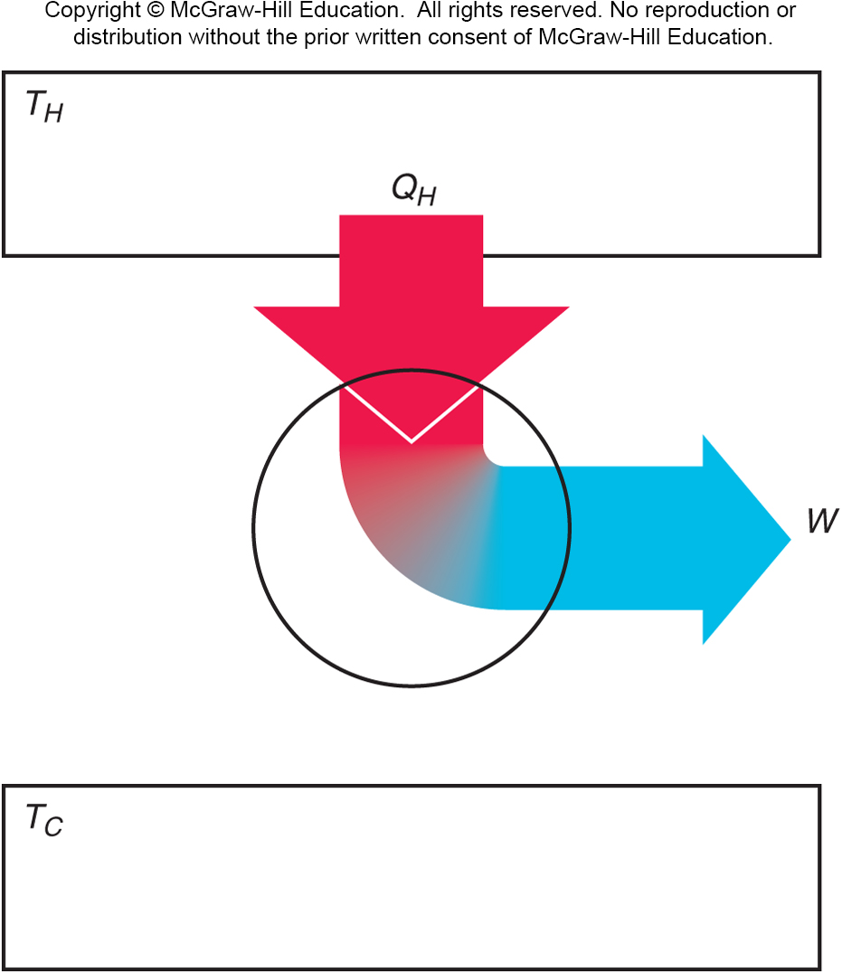
A perpetual-motion machine of the second kind does not put more energy out than goes in.
Instead, it may claim to be able to take heat from a reservoir at a single temperature and convert it completely to work.
This violates the second law of
thermodynamics: some heat
must be released into a lower-
temperature reservoir.
Or, it may simply claim a higher
efficiency than the Carnot efficiency
(for the available temperature
difference).
Such claims may be put forward by
well-intentioned but misguided persons.
Some are promoted by charlatans.

Slide 49
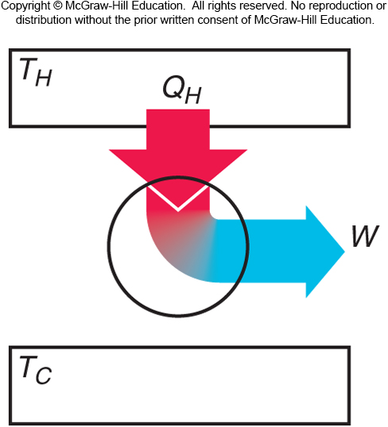
Is it possible for a heat engine to operate as shown in the following diagram?
Yes
No, not ever
Only if it is a Carnot engine
It depends
This is a perpetual-motion machine of the second kind. According to the second law of thermodynamics, heat can never be completely converted to work without some waste heat released.

Slide 50
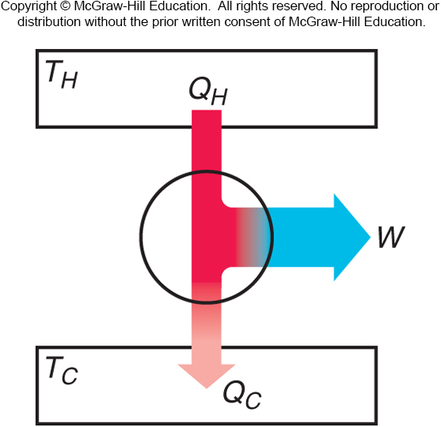
Is it possible for a heat engine to operate as shown in the following diagram?
Yes
No, not ever
Only if it is a Carnot engine
It depends
This is a perpetual-motion machine of the first kind. According to the first law of thermodynamics, you can never get out more energy in work than you put in as heat.

Slide 51
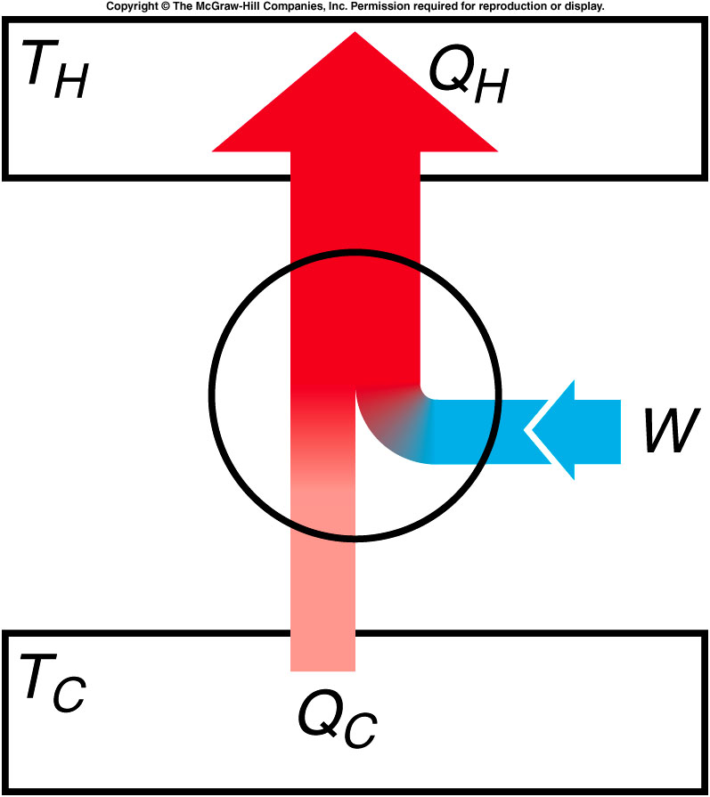
Is it possible for a heat pump to operate as shown in the following diagram?
Yes
No, not ever
Only if it is a Carnot engine
It depends
This diagram is correct!!!
More heat is transferred to the hot reservoir than is taken in from the cold one, with work being done.

Slide 52
Thermal Power Plants and Energy Resources
The most common way of producing electric power in this country is a thermal power plant that uses some form of heat engine, whether fueled by coal, oil, or natural gas (fossil fuels).
Thermodynamics plays an extremely important role in any discussion of the use of energy.
As worldwide economic development continues and fossil-fuel resources are depleted, questions of the optimal uses of energy resources become critical.
Wise decisions depend on the participation of an informed, scientifically literate citizenry.

Slide 53
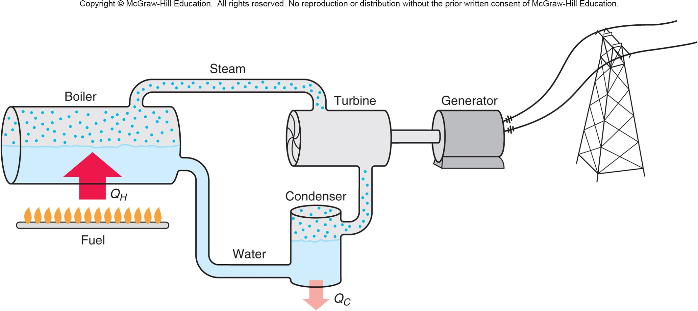
Thermal-Electric Power Plant
Fossil fuel (coal, oil, natural gas) is burned to release heat that causes the temperature of water and steam to increase.

Slide 54
Thermal-Electric Power Plant
Hot steam is run through a turbine (a heat engine) that turns a shaft connected to an electric generator.

Slide 55
Thermal-Electric Power Plant
Electricity is transmitted through power lines to consumers.

Slide 56
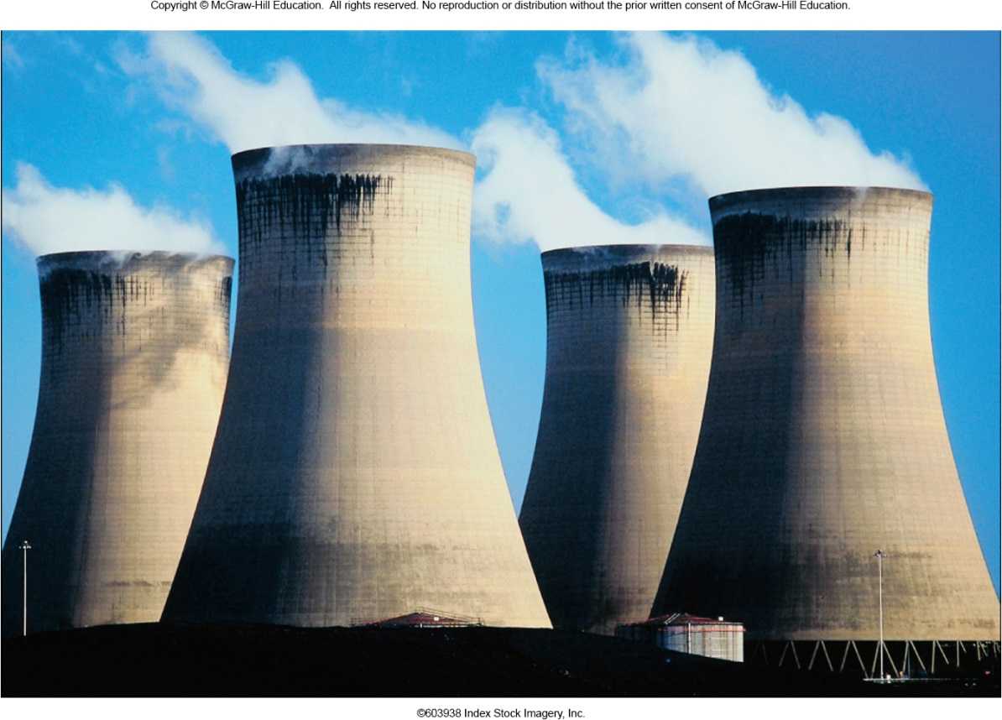
In practice, only about half the thermal energy released in burning coal or oil is converted to mechanical work or electrical energy.
The rest must be
released into the
environment at
temperatures too
low for running
heat engines.
Cooling towers
transfer this waste
heat into the
atmosphere, or
heated water is
released into a river.

Slide 57
Alternatives to Fossil Fuels
Nuclear power plants
Lower thermal efficiencies
More heat released into environment
No carbon dioxide and other greenhouse gases released
Nuclear waste must be processed and disposed of

Slide 58
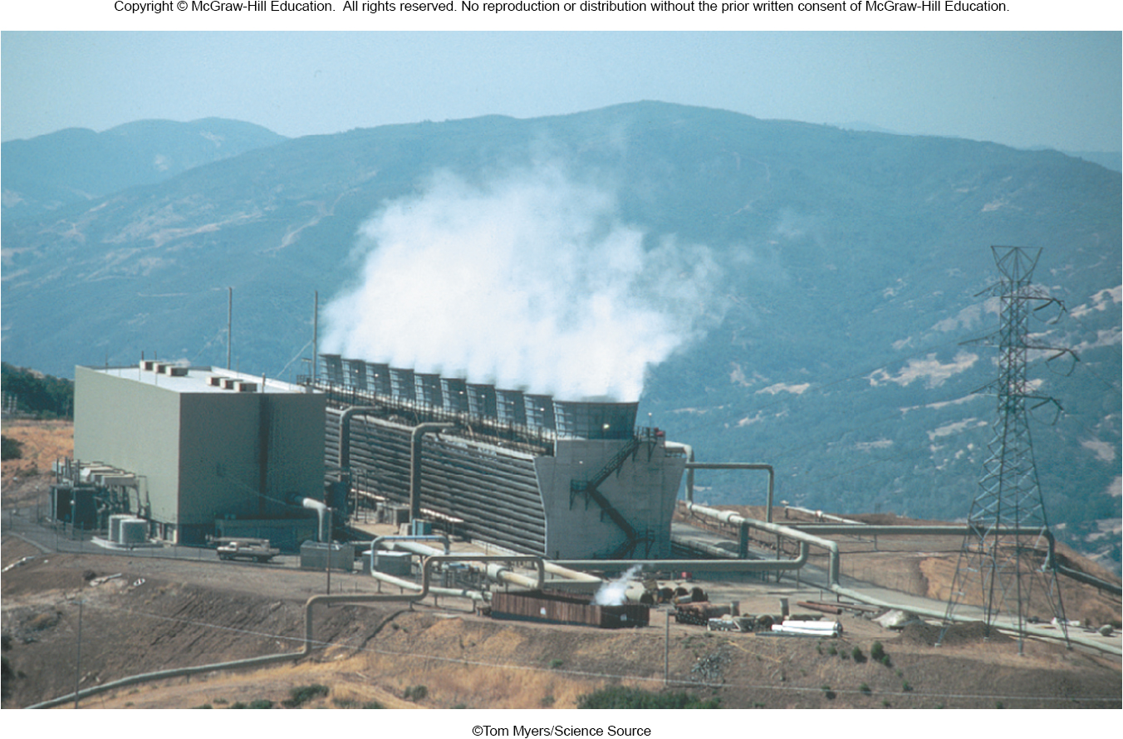
Geothermal Energy
Heat from the interior of the earth, such as hot springs and geysers.
Water temperature not hot enough to yield a high efficiency
Geysers Power Plant in California

Slide 59
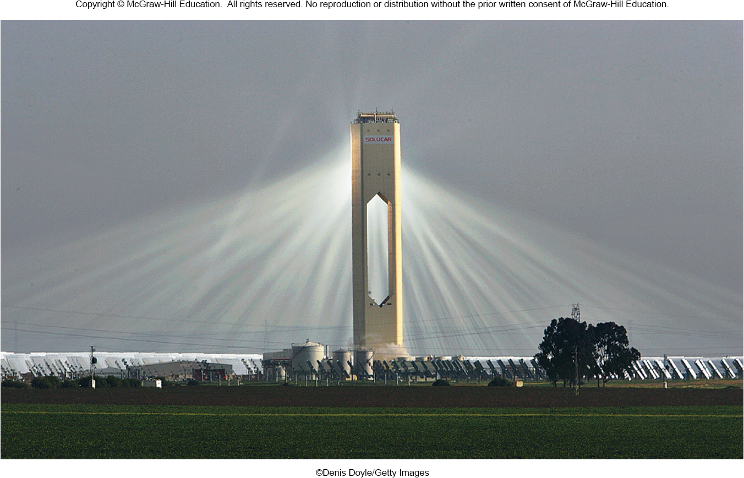
Sun as energy source
Warm ocean currents
Solar power
Mirrors focus sunlight to heat a central boiler at a solar-thermal power plant

